Slide 1
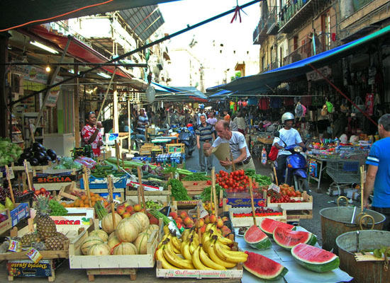
UBUNTU
A space of inclusion
in the heart of Palermo

Slide 2

Ubuntu
” Ubuntu does not mean not thinking about yourself
Rather, it means asking the question:
Do I want to help growing the community around me? ”
Nelson Mandela

Slide 3
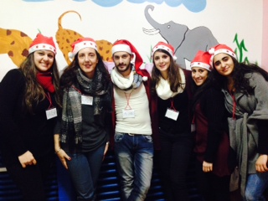
Who are we...
UBUNTU is a voluntary association founded in 2006 in the heart of Ballarò in the center of Palermo. Following the philosophy inspired by the name, it was born with the aim of helping immigrant families living and working in the city of Palermo.
UBUNTU's support to immigrant families is carried out in the care of their children, so that the parents can go to work with the tranquility of knowing that there is a group of people who takes care of their little ones: takes them to school, prepares them lunch, follows them after school, play with the children, develops their creativity, helps them integrate into the community!

Slide 4
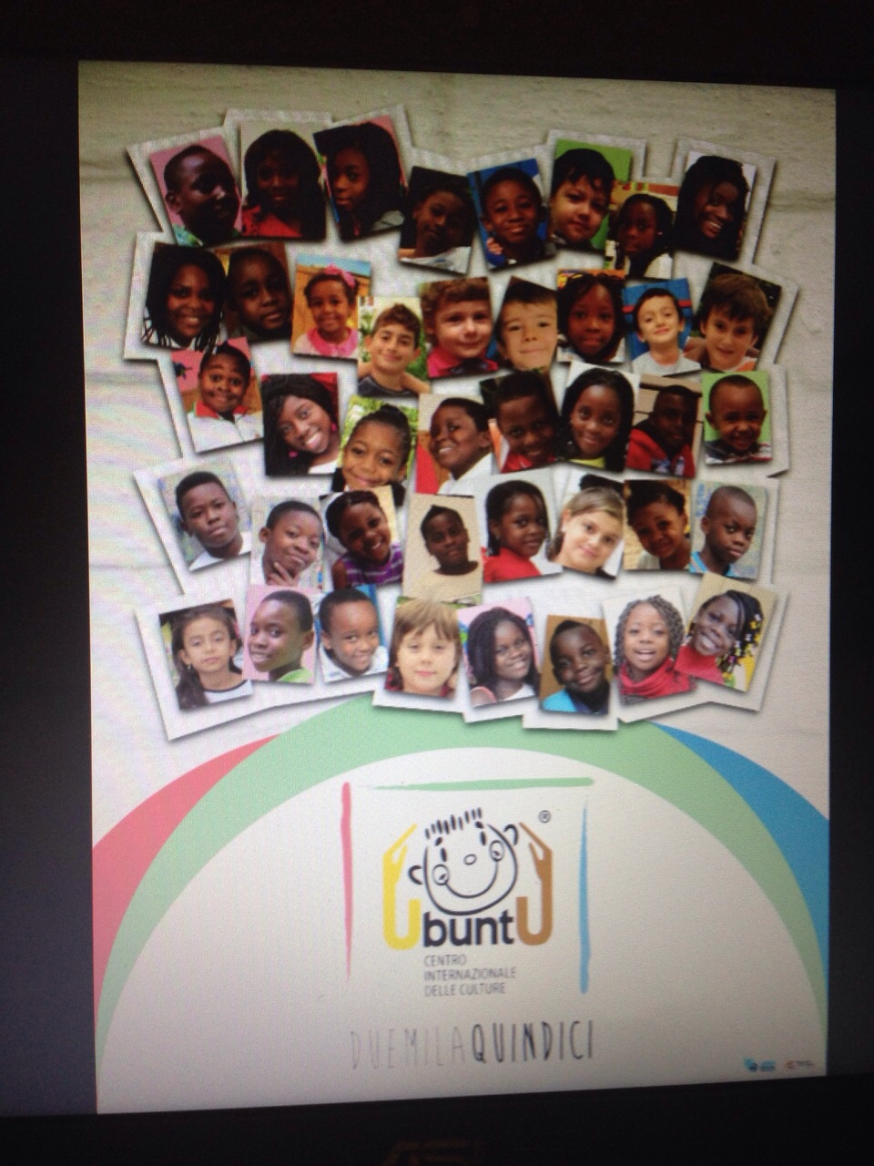
Target groups
Children from 0 to 3 years old during the morning
Children attending elementary and secondary school
Families of children attending UBUNTU: this is the home of children and their parents!
The structure is currently attended by 50 children and their families.

Slide 5
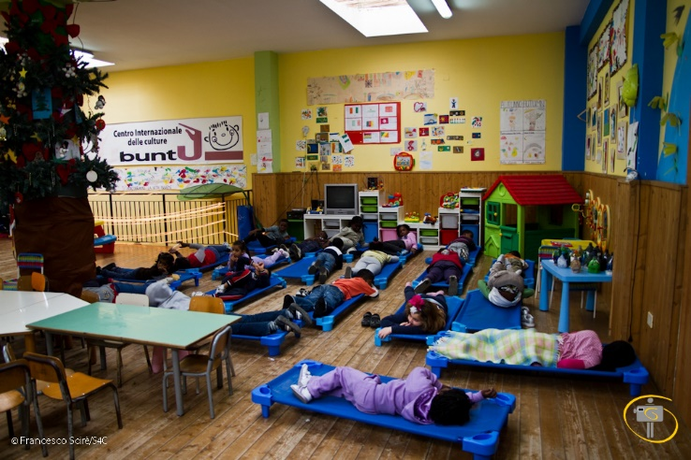
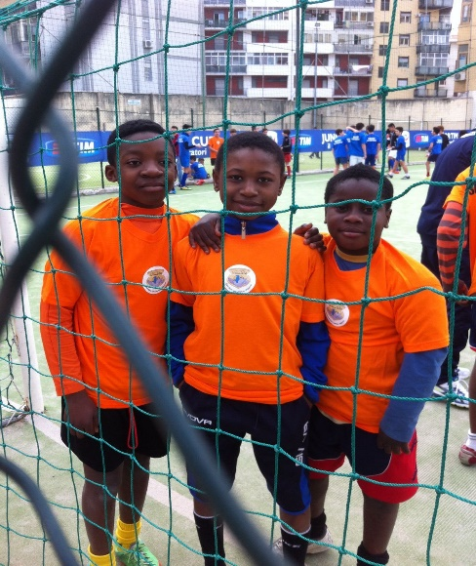
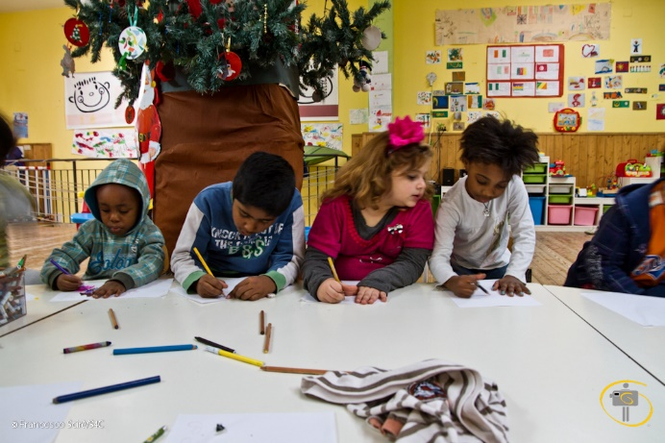
Daily activities…..
Baby parking for the youngest who are not attending school or (even more!) for those who have not been admitted to public structures managed by the Municipality for lack of places. They are obviously inadequate to meet the needs of the territory!!! The Ubuntu center hosts children from all ethnicities and from different neighborhoods in the city. Through an intercultural approach aimed at inclusion, the center is able to offer innovative services for individual and collective growth and to develop social freedom. Children are taken to the school by volunteers with a small bus and brought to the nursery where a delicious lunch is waiting for them!
School Support Services: some volunteers help children to do their homework with ease.
Fun Time : playful and creative labs that promote teamwork between subjects of different ages. The center organizes "alternative" workshops: theatrical, musical, design and color, art, creativity, creative recycling, cooking and learning foreign languages.

Slide 6
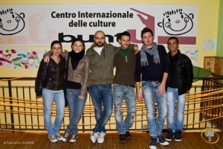
Partners
UEPE: External criminal enforcement offices
USSM:Social Service for Minors office
SVE: European voluntary service
Local volunteers

Slide 7
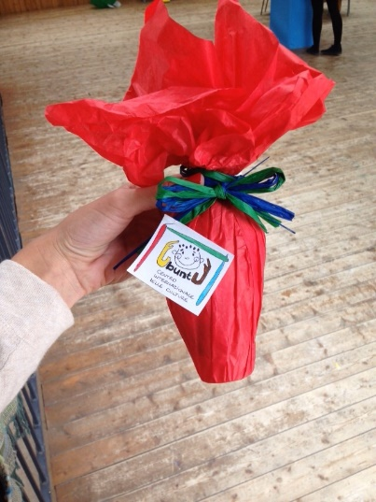
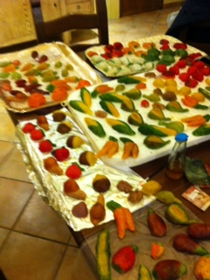

How do we survive...
The institutions do not help us!!!
The municipality has given us a local management (which we have completely restored), from which it now receives the rent!
Thanks to public and private benefactors, we have been able to continue helping immigrant children and their families.
Self-financing projects such as the creation of calendars or the production of cookies or easter eggs for fundraising.

Slide 8
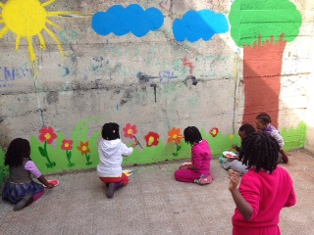
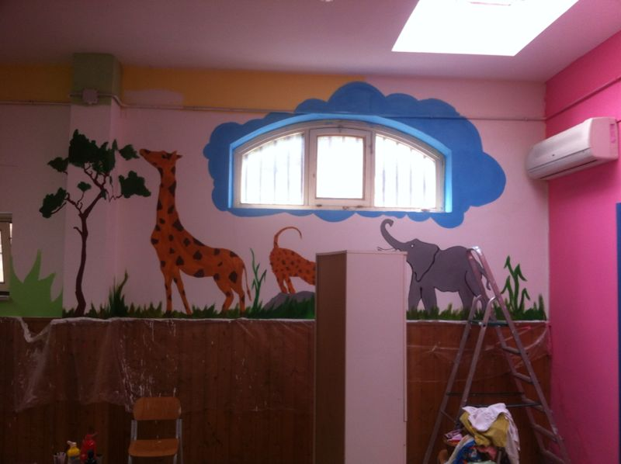
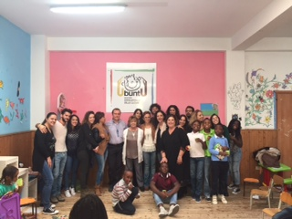
Our spaces...

Slide 9
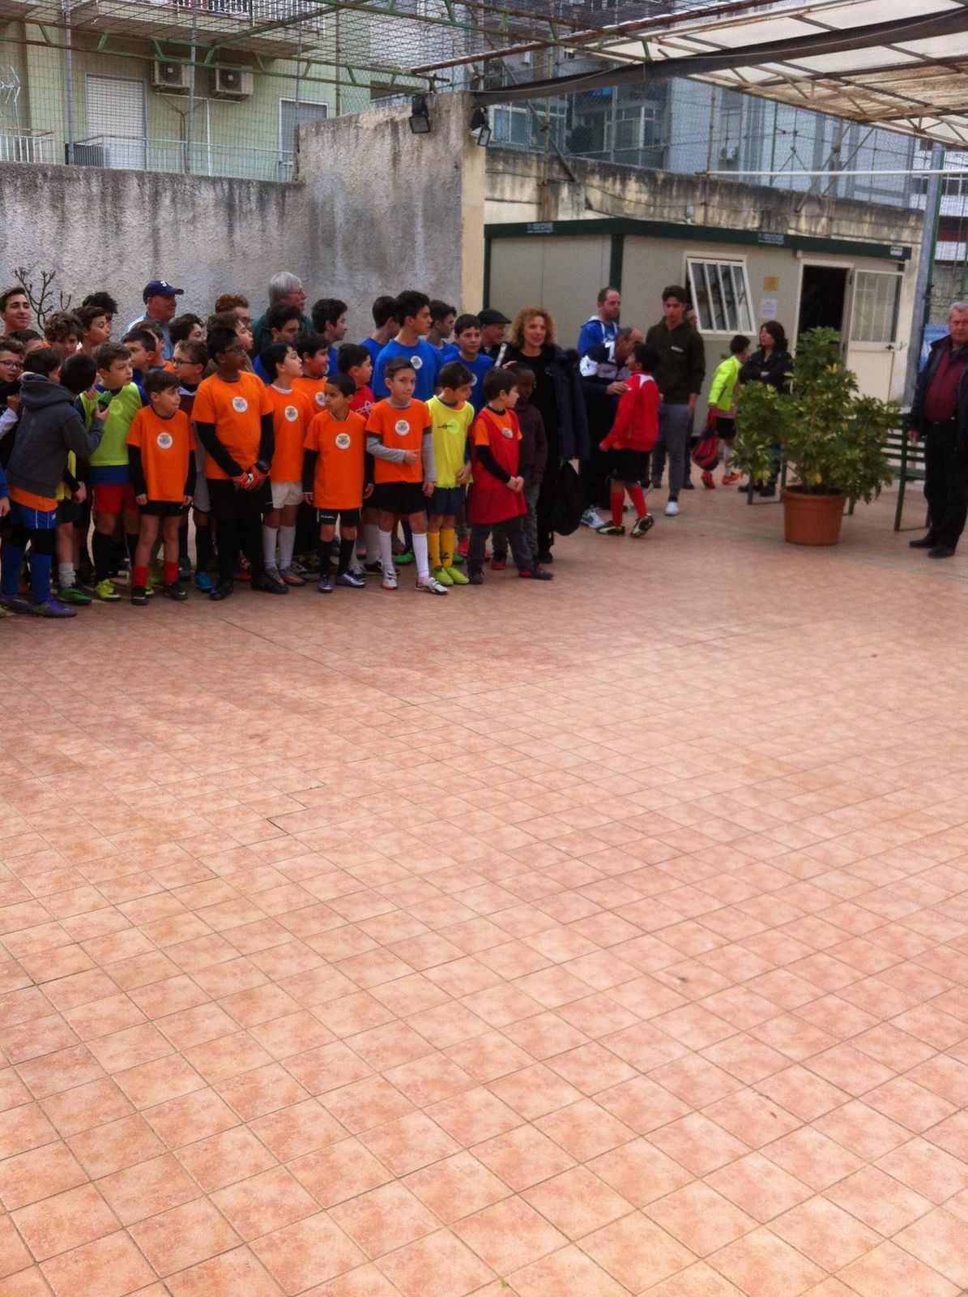
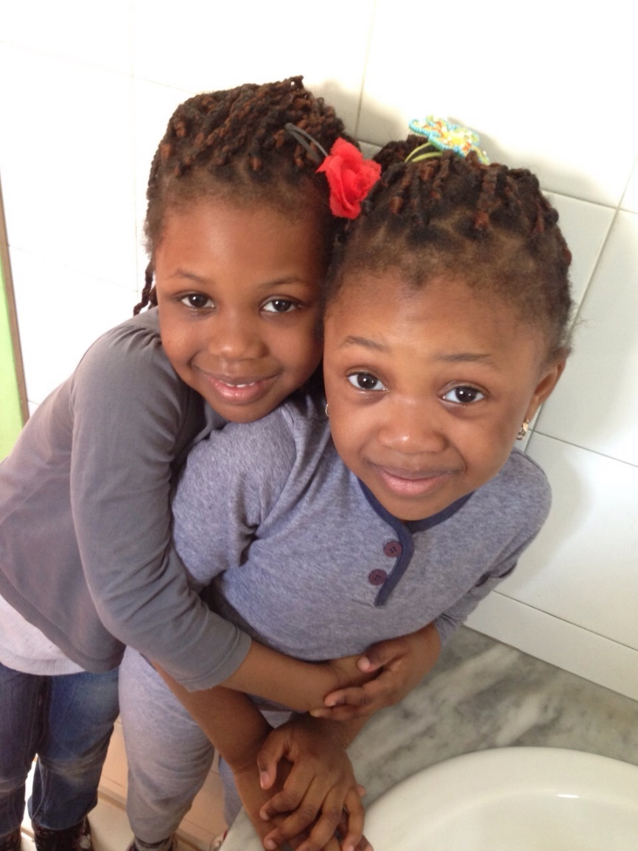
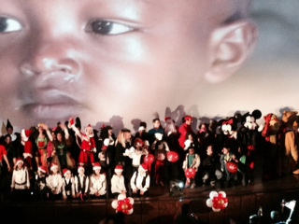
Our children…

Slide 10
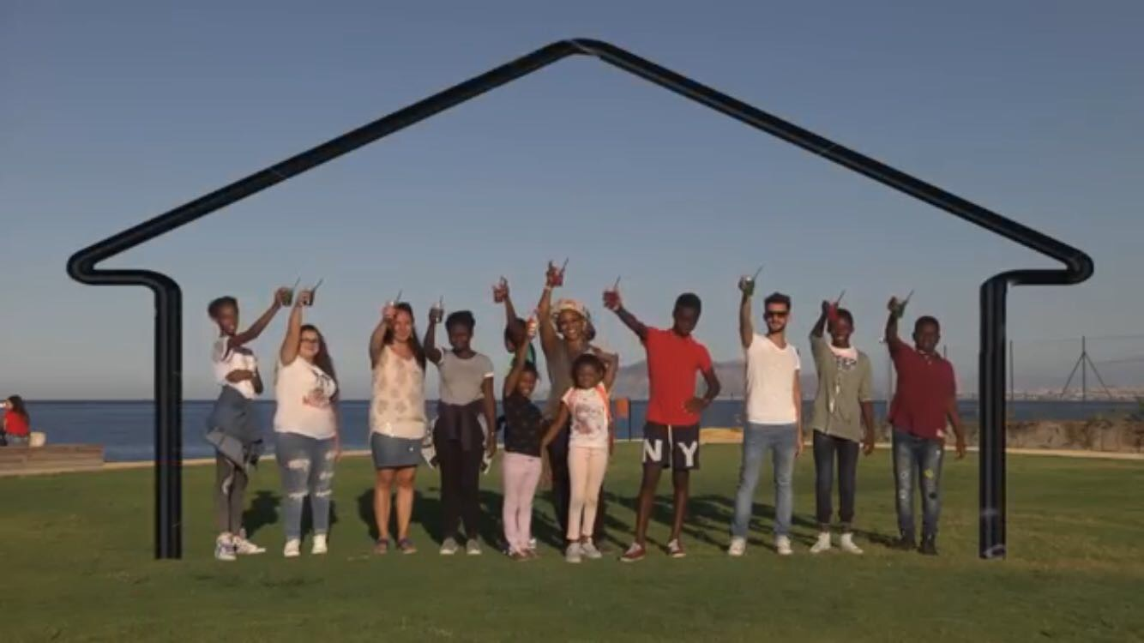
Our areas of intervention...
The main areas of design and intervention are:
Early school leaving
Social Inclusion in Formal and Non-Formal Education
Education of young people
Volunteering promotion
Valorization of assets confiscated from mafias

Slide 11
Our current projects...
Partner in the project "Everywhere", for three years, addressed to children aged 0-6 years and aimed at combating child poverty, funded by a bank-based foundation
Partner in the "Park of Health" project for the creation of a public park without barriers to promote social inclusion, funded by a bank foundation
Partner in the project "Badanturi" to train migrant careers, funded by the Ministry of Labor

